Slide 1
From fiber-length distribution to yarn performance: end-use evaluation of qFL-Chr.25 in cotton near-isogenic introgression lines
End Use Evaluation Manuscript Update
Sep 21, 2026

Slide 2
Study Objective/ Manuscript Questions
Does qFL-Chr.25 improve end-use performance, not just fiber-length metrics?
Does the upper-tail fiber phenotype persist through processing?
Which fiber measurements best predict yarn performance?
Are responses consistent across NIIL pairs?
Note: qFL-Chr.25 alters the upper portion of the fiber-length distribution, and this phenotype appears to persist through processing and relate to yarn tenacity, although yarn response varies among sister-line pairs.

Slide 3
Experimental Design/Matched Fiber-to-Yarn Workflow
2022 field plot → machine harvest → microgin → common lint lot → HVI / AFIS / fibrogram → MiniSpin processing → yarn testing
92 total samples
64 formal NIIL observations (16 genotypes x 4 field reps)
16 NIIL genotypes
8 sister-line pairs
4 genetic backgrounds
same lint lot linked to fiber and yarn measurements

Slide 4
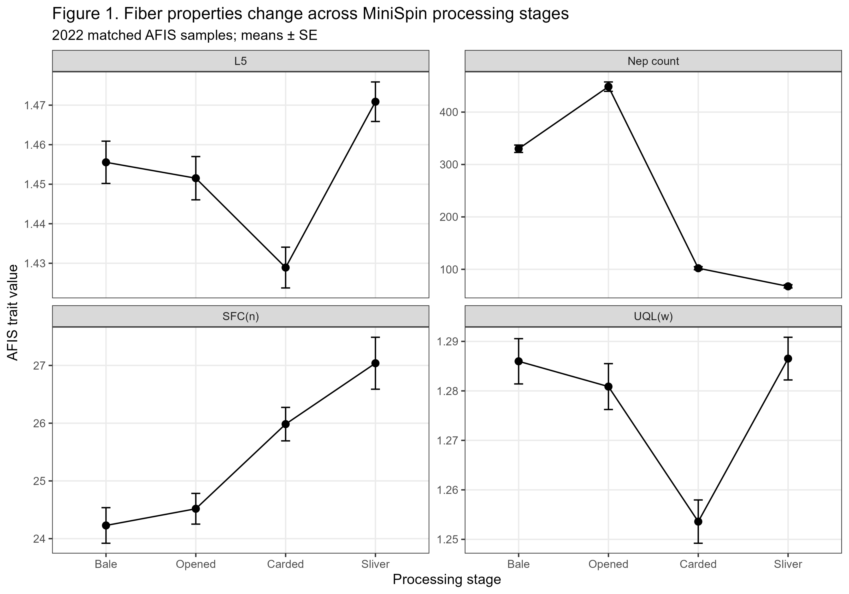
Take away: Processing substantially altered AFIS fiber properties: upper-tail length declined through carding and recovered in sliver, short-fiber content increased, and nep count dropped sharply after carding. This figure summarizes the overall processing effect across samples rather than a QTL-specific response.

Slide 5
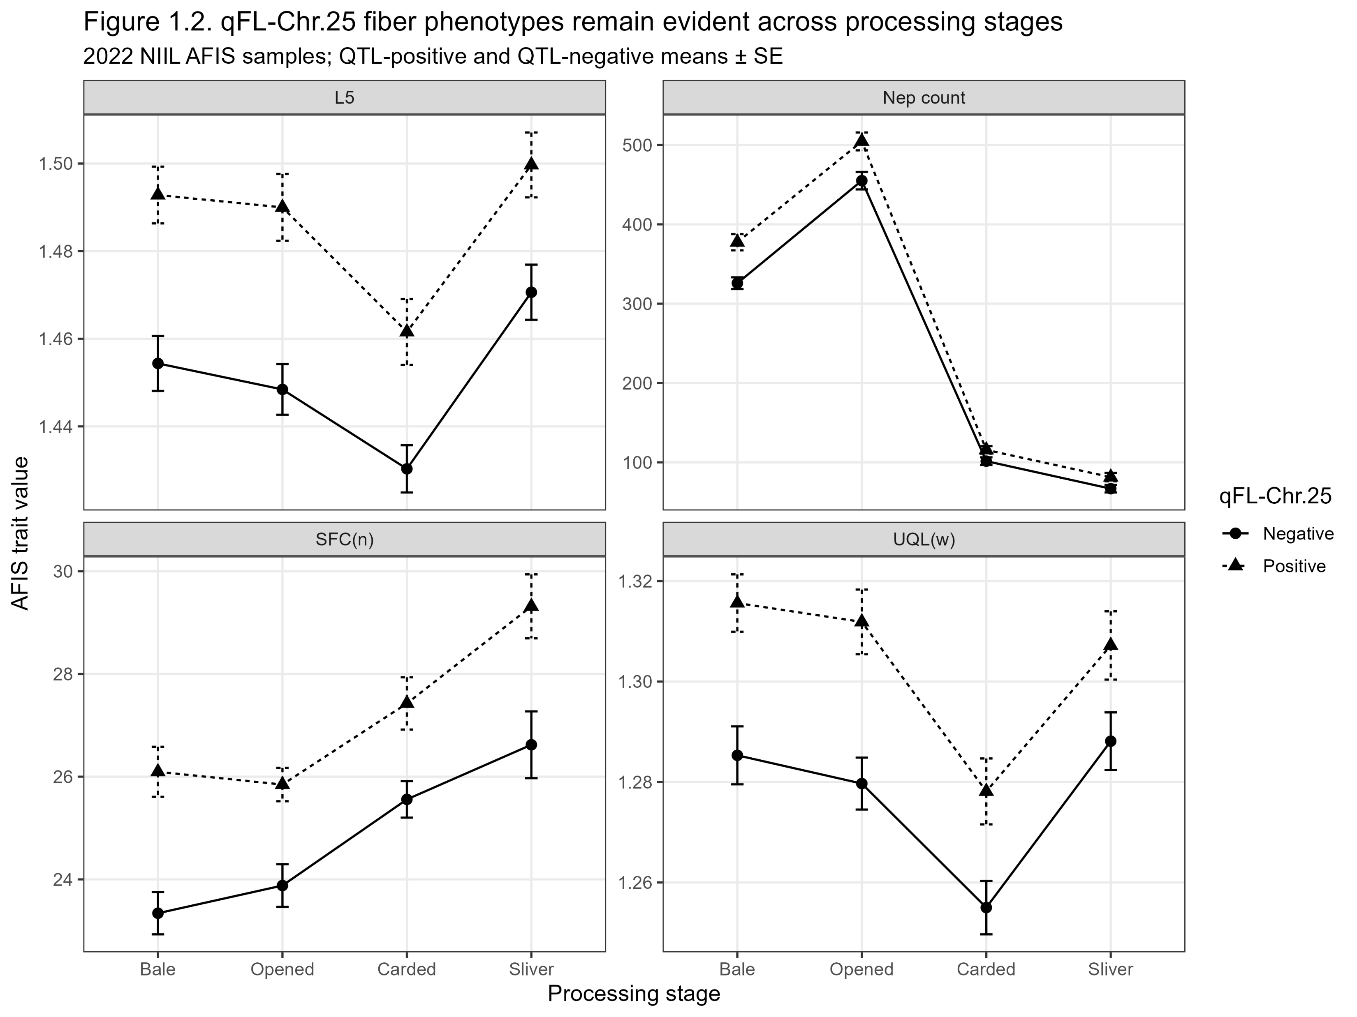
Take away: qFL-Chr.25-positive lines maintained higher L5 and UQL(w) across processing stages, indicating that the upper-tail length phenotype remained evident through processing. QTL+ lines also showed higher SFC(n), while nep-count differences diminished after carding; Nep count was the trait with the clearest QTL × stage response.

Slide 6
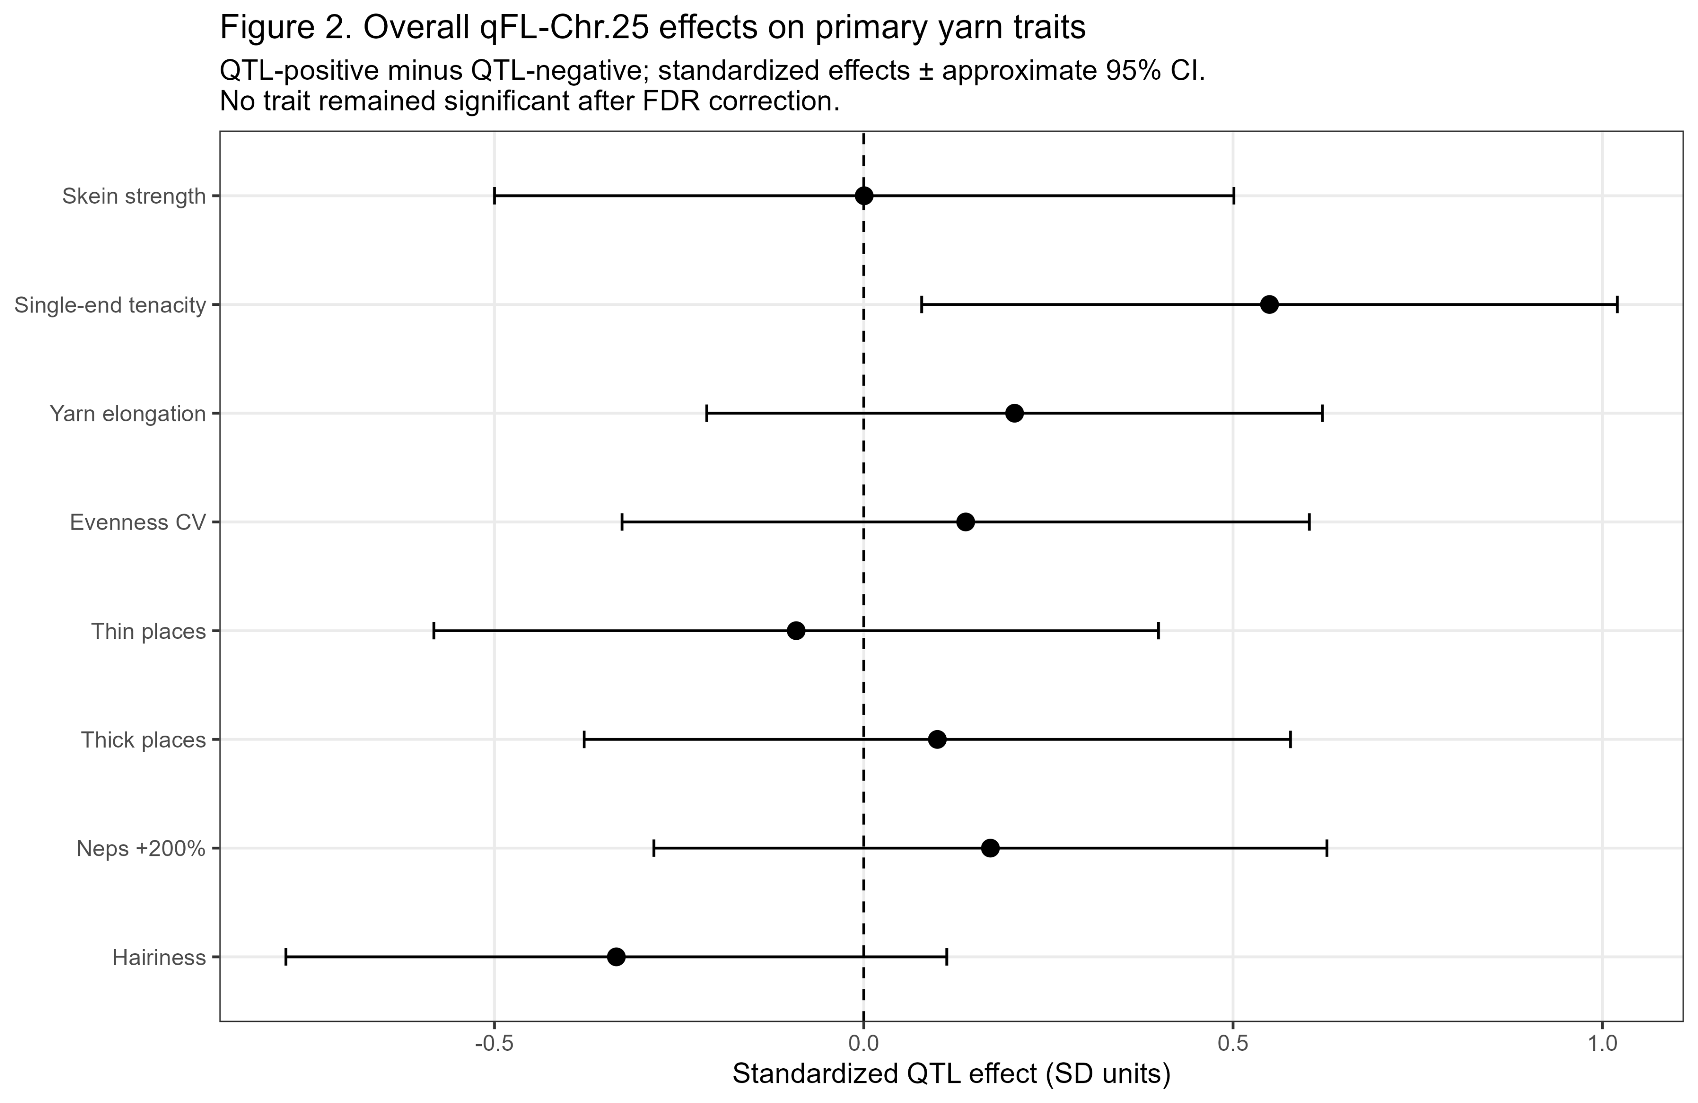
Take away: qFL-Chr.25 showed its clearest overall yarn response in single-end tenacity, with smaller or inconsistent effects on the other primary yarn traits. However, no trait remained significant after FDR correction, indicating that the QTL’s end-use effect is modest in the overall NIIL analysis and likely stronger in specific NIIL pairs than as a uniform response across backgrounds.

Slide 7
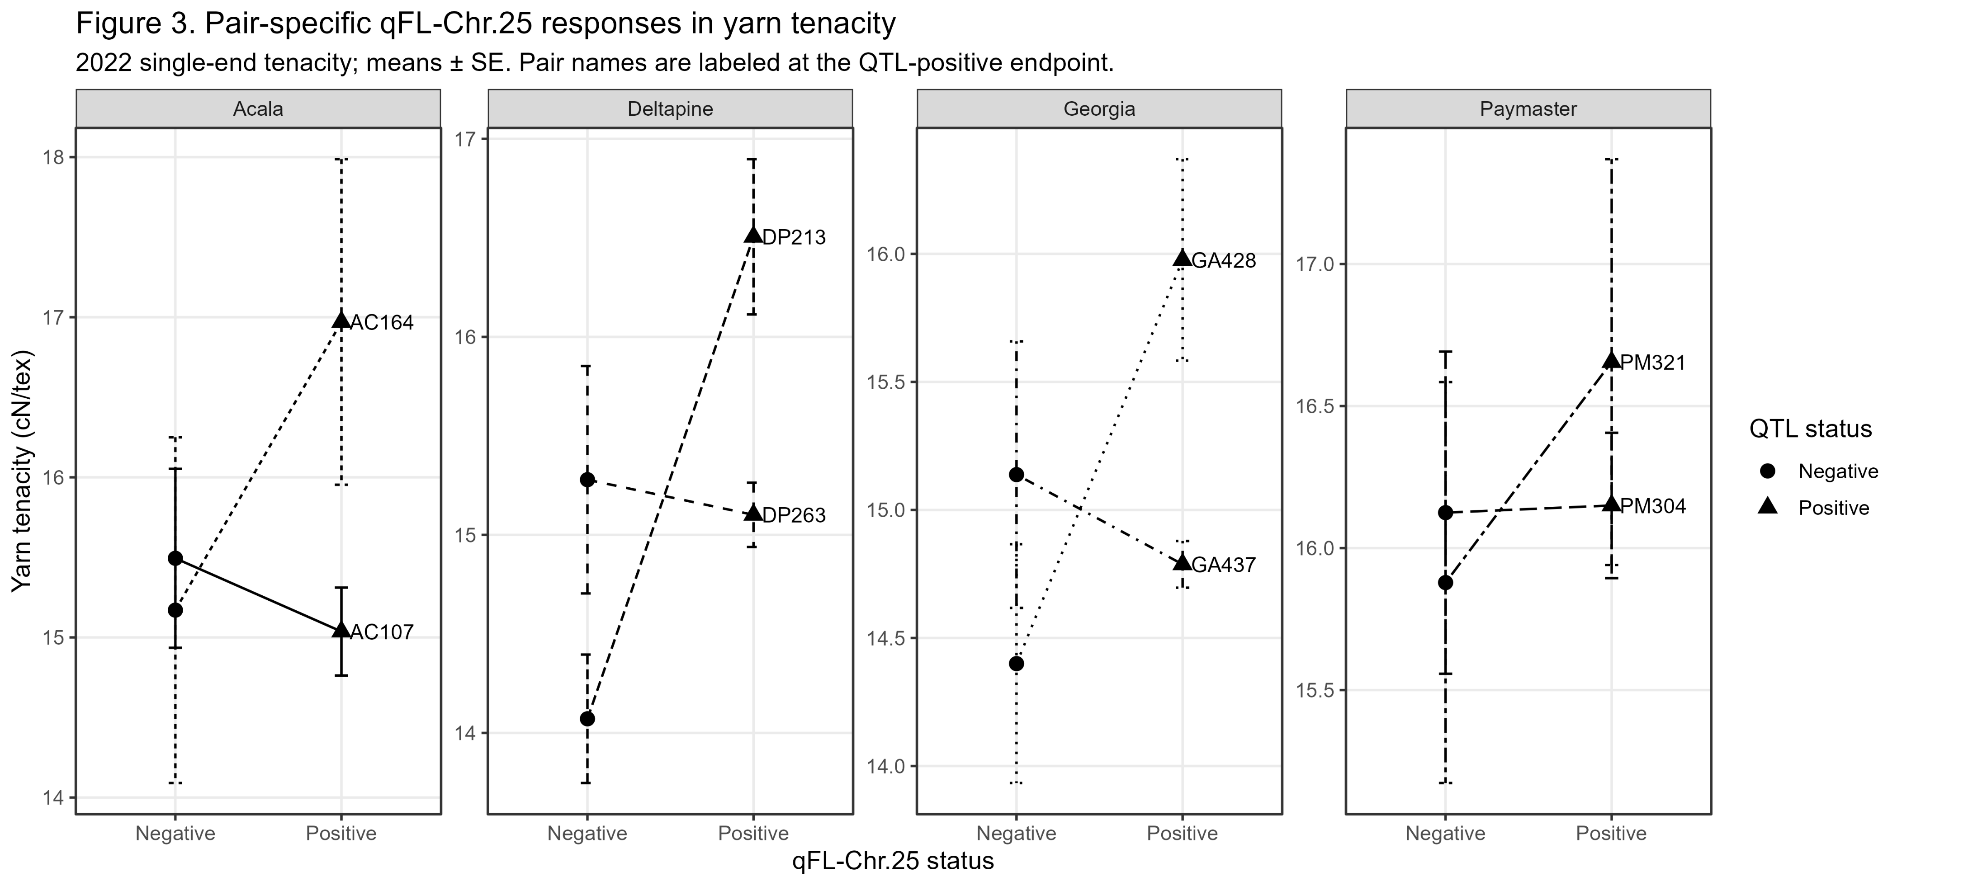
Take away: Yarn-tenacity responses were not uniform across sister-line pairs. DP213 showed the strongest positive qFL-Chr.25-associated response, while other pairs showed smaller or opposite changes. These patterns show heterogeneous pair-level responses, but the formal background × QTL interaction was not significant; therefore, the results support pair-specific differences rather than a general background-dependent QTL effect.

Slide 8
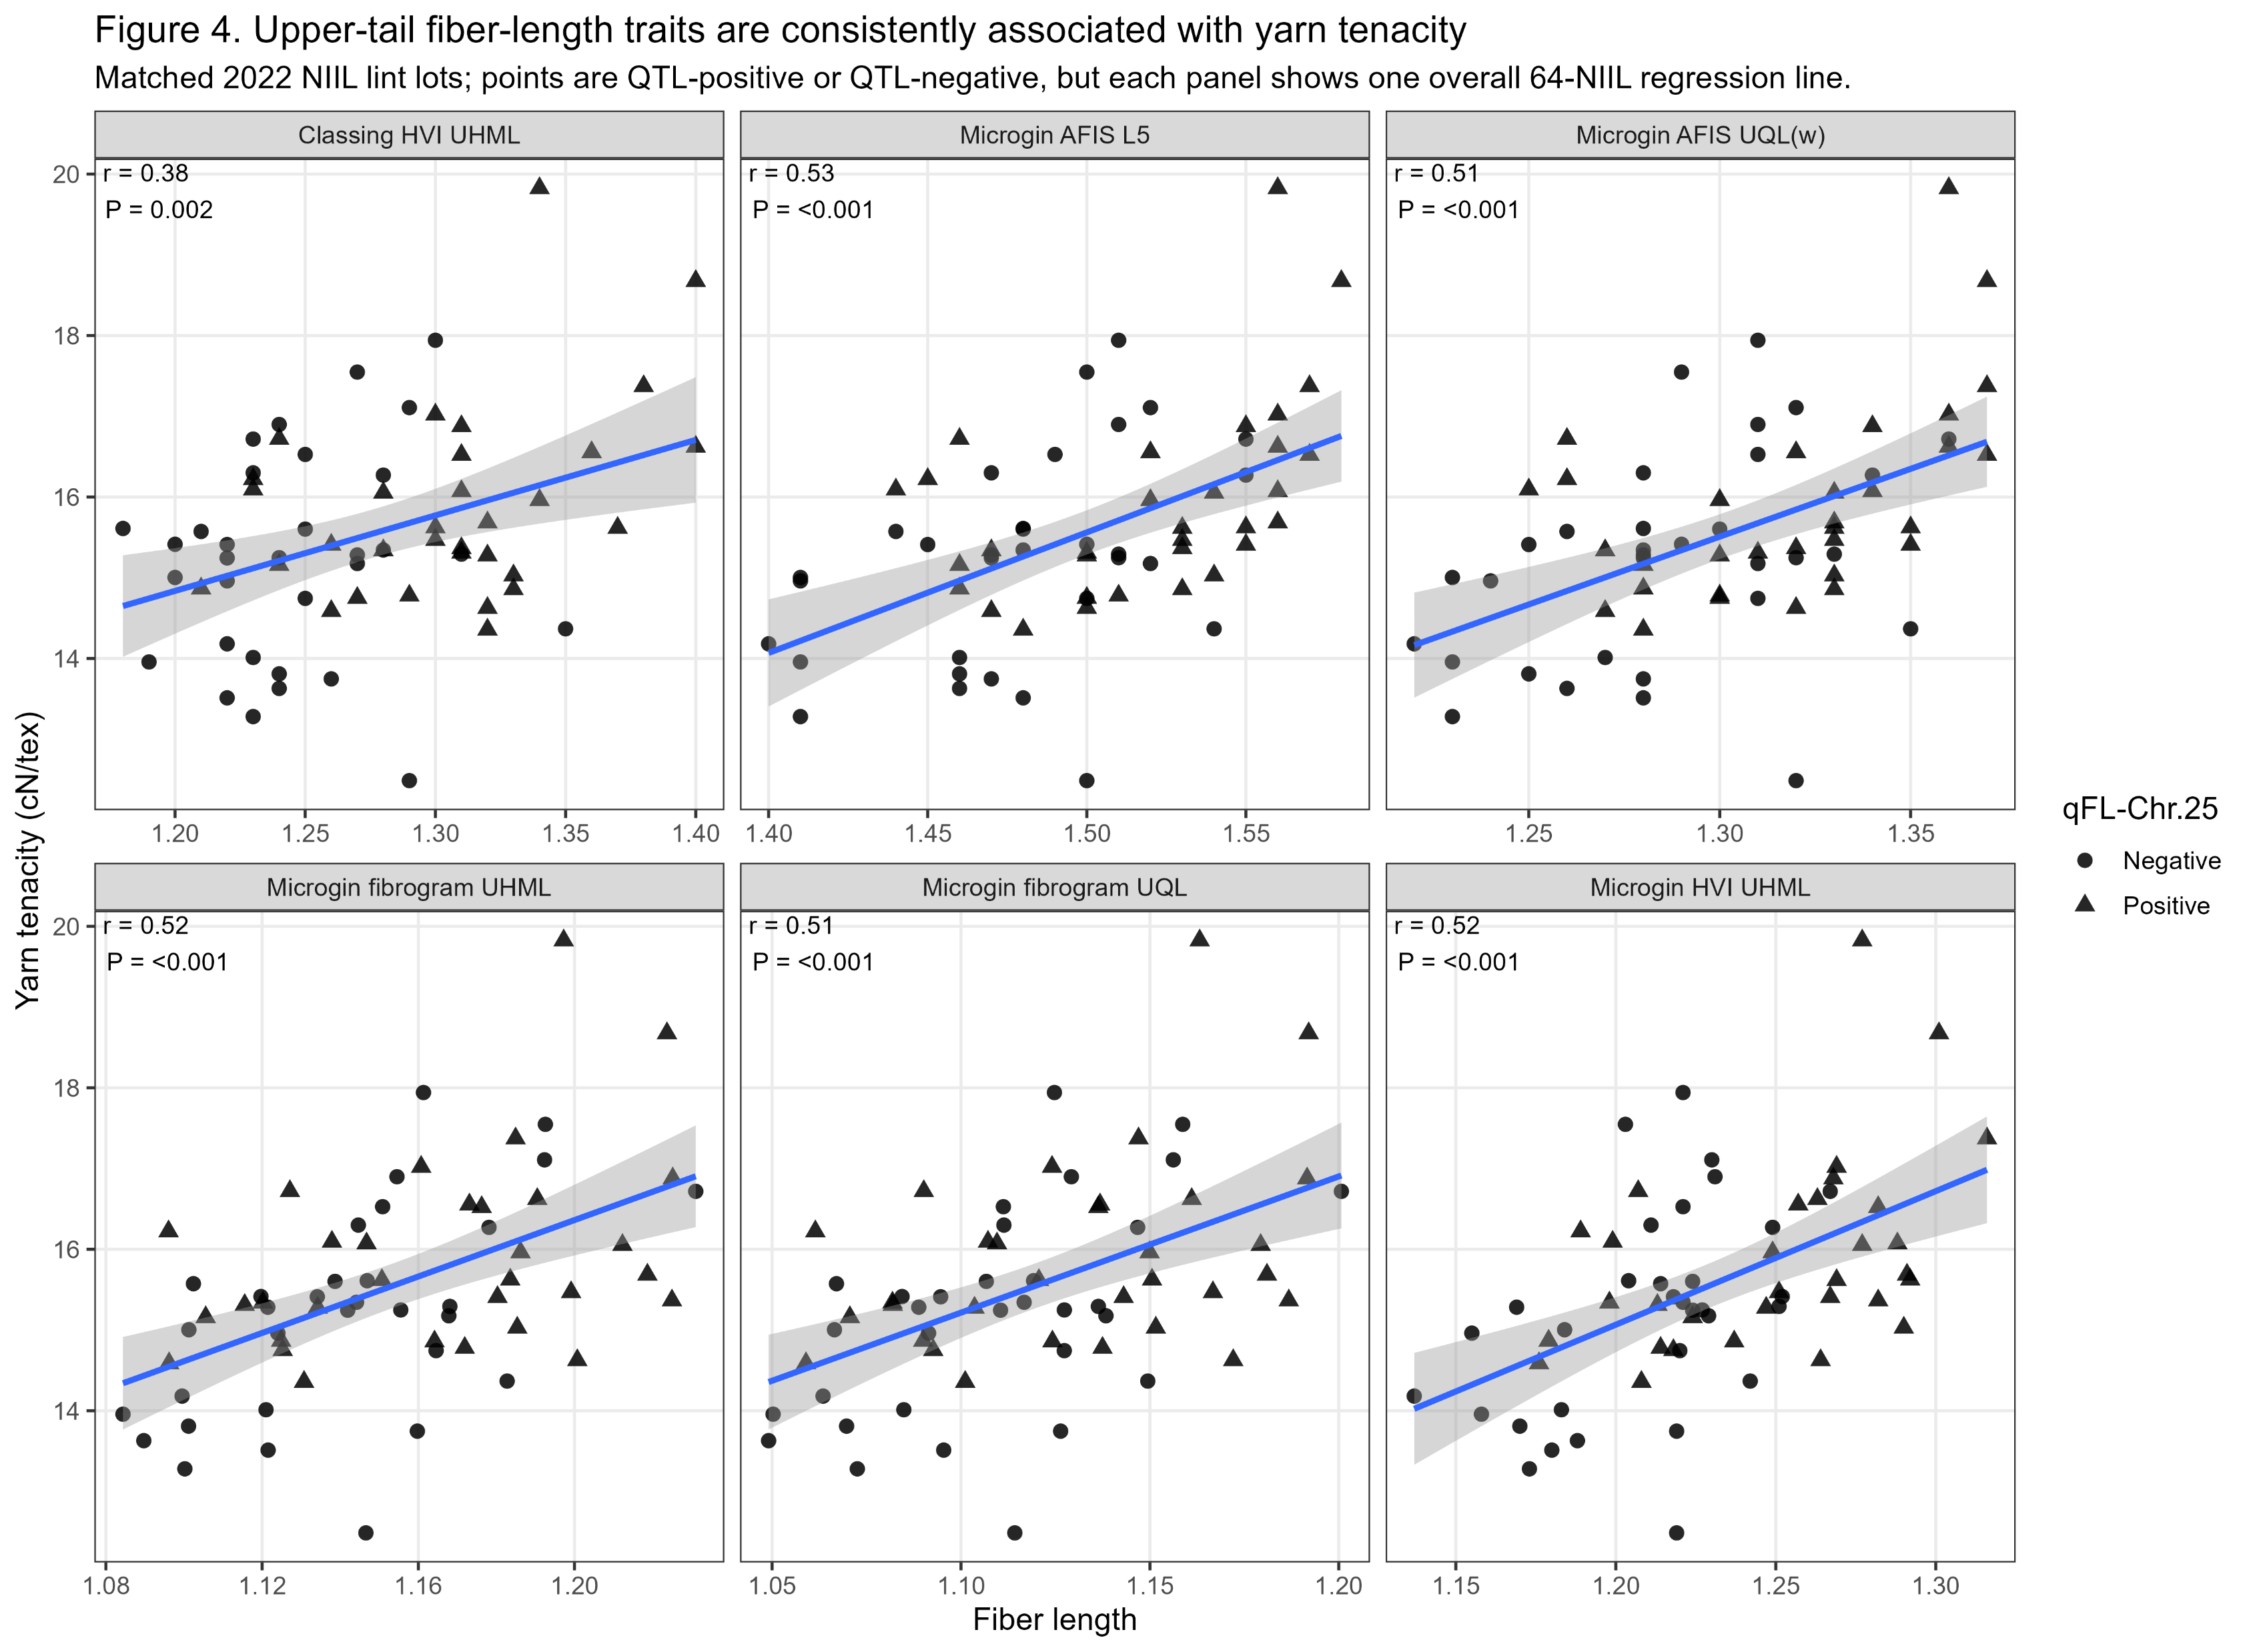
Take away: Upper-tail fiber-length measurements from HVI, AFIS, and fibrogram systems were consistently and positively associated with yarn tenacity across the 64 NIIL plot-level observations. The repeated signal across independent measurement platforms strengthens the evidence that longer upper-tail fibers are closely linked to improved yarn strength in this material.

Slide 9
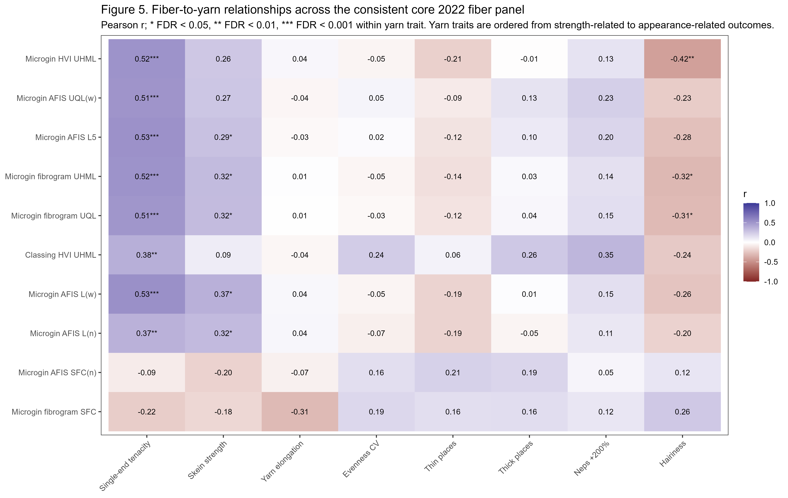
Take away: Fiber-length traits showed the strongest and most consistent relationships with yarn strength, particularly single-end tenacity. Upper-tail measurements generally showed the strongest associations, although broader distribution measures such as Ln were also related to tenacity. Relationships with yarn evenness, imperfections, and hairiness were weaker and less consistent.

Slide 10
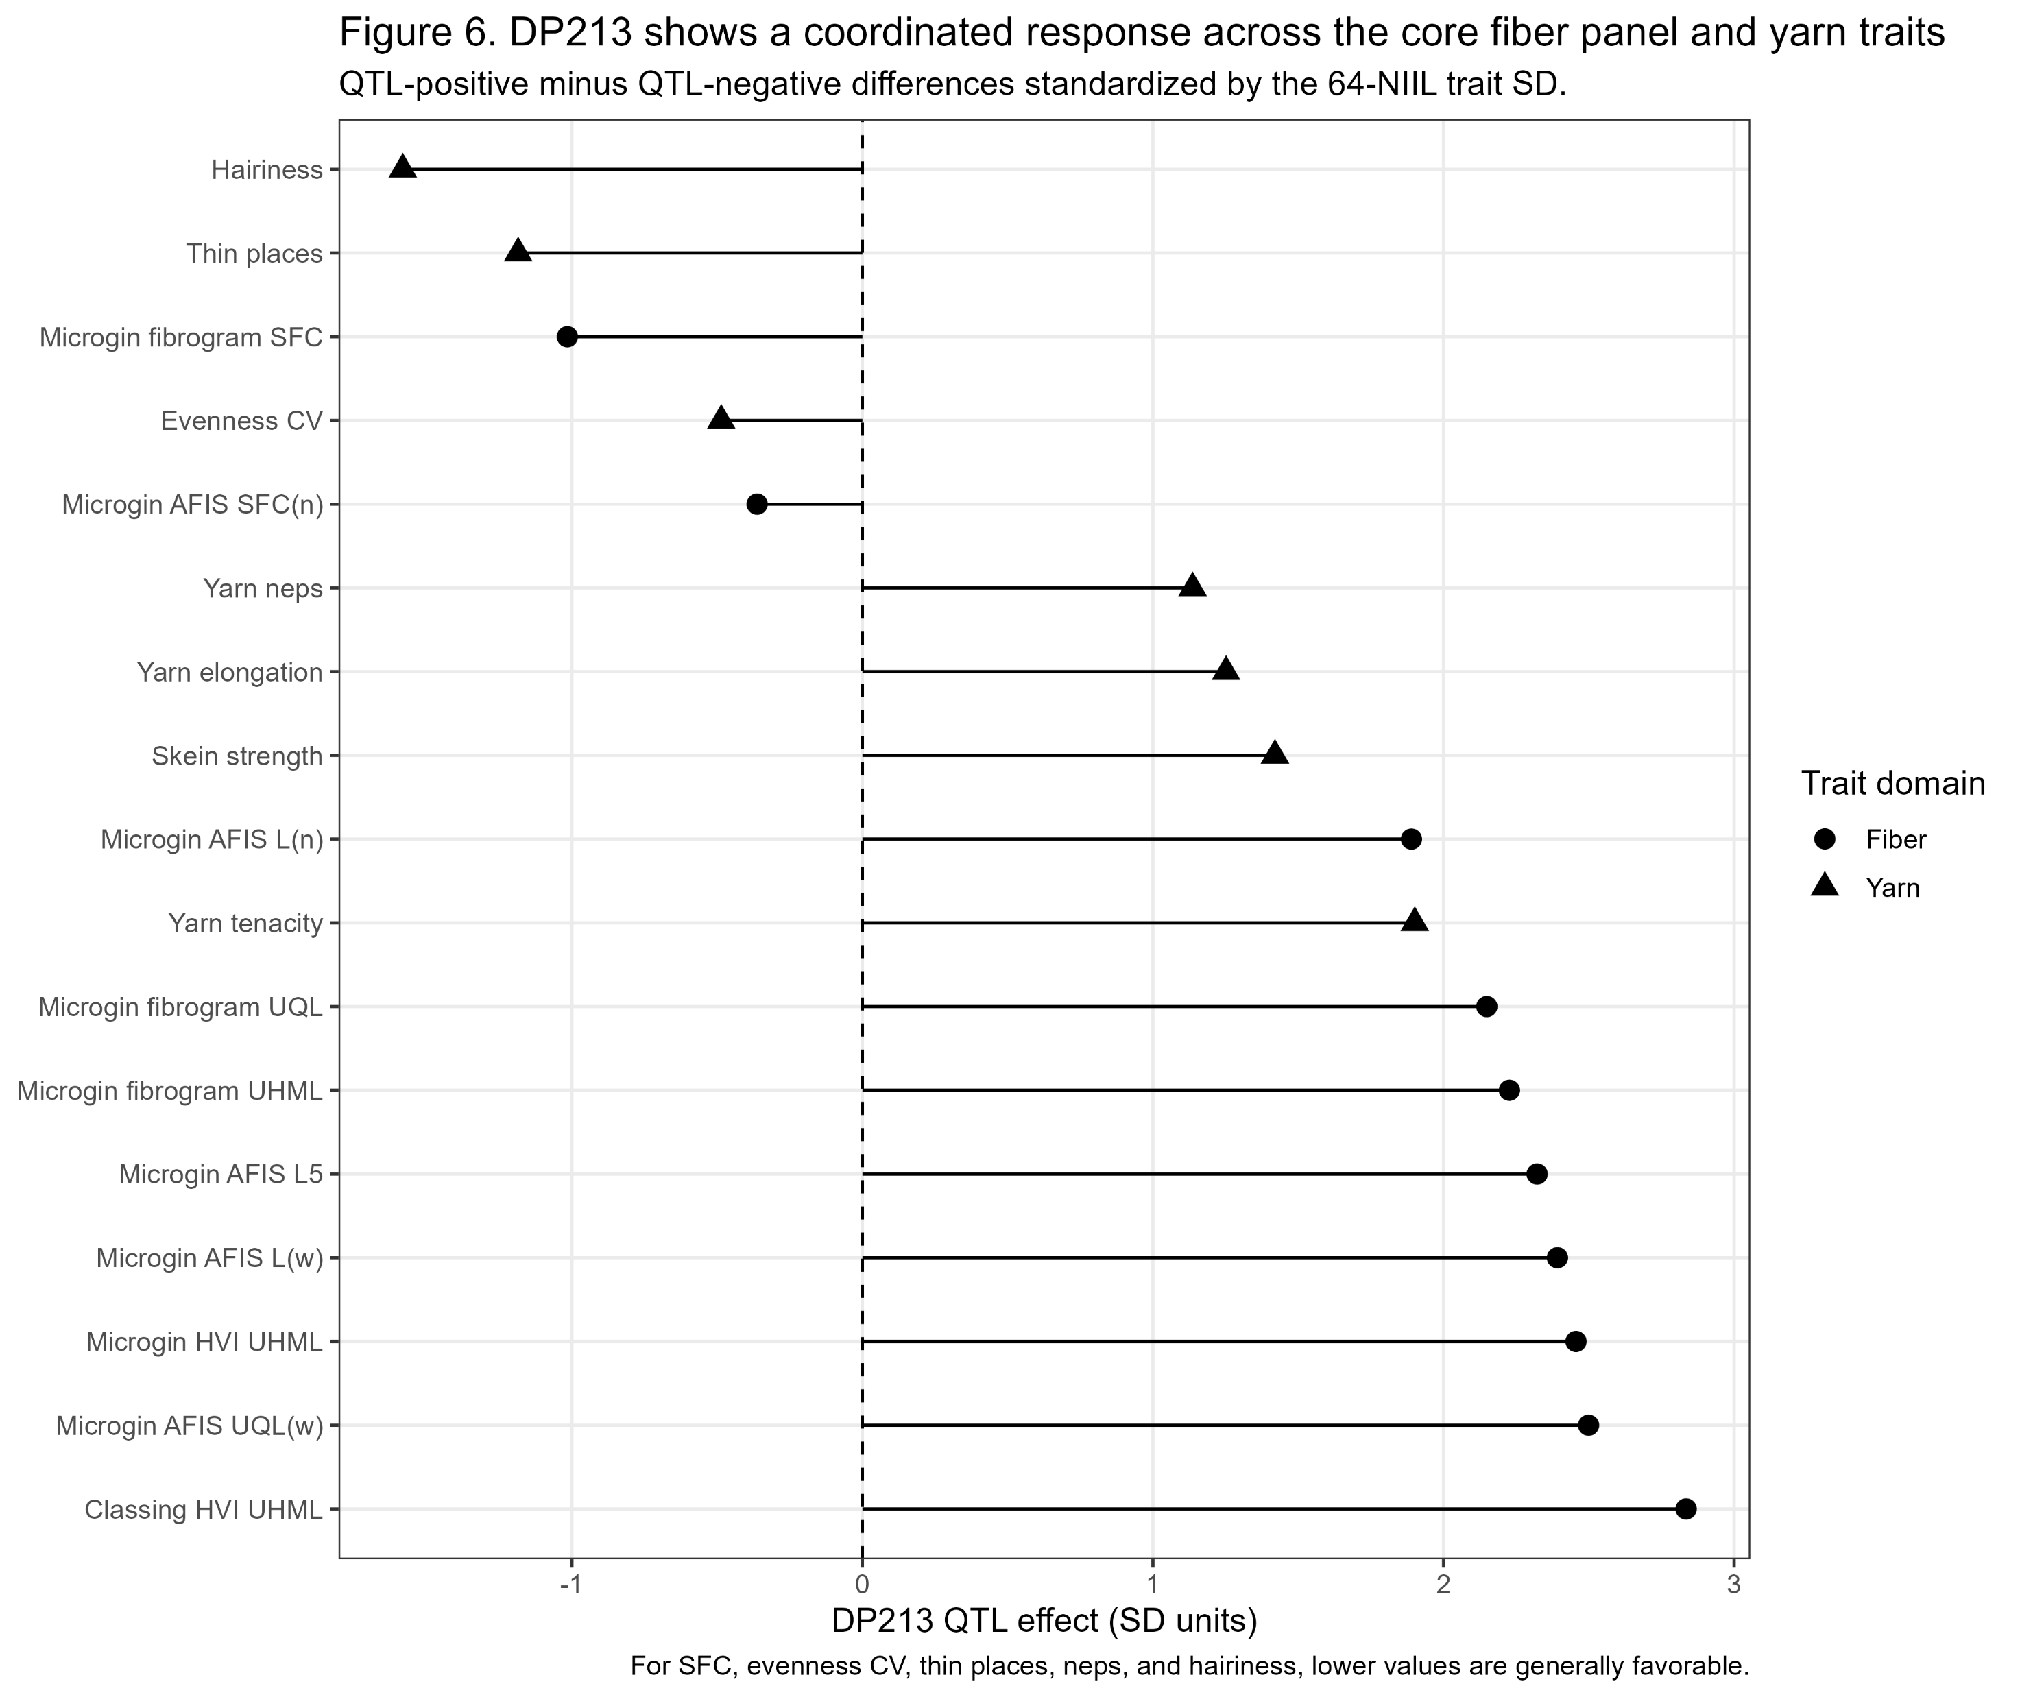
Take away: DP213 provided the clearest example of coordinated fiber-to-yarn translation, with longer upper-tail fibers and lower short-fiber measures occurring alongside greater yarn tenacity and skein strength and lower hairiness and thin places. This pattern is descriptive for this sister-line pair and should not be interpreted as evidence that every individual trait difference is independently significant.

Slide 11
Integrated Results Summary
Processing: MiniSpin processing substantially altered fiber properties, particularly through carding.
QTL persistence: qFL-Chr.25-positive lines retained higher upper-tail fiber length through processing; Nep count showed the clearest QTL × processing-stage response.
Yarn response: Overall yarn effects were modest, with single-end tenacity showing the clearest positive response and heterogeneous responses among sister-line pairs.
Fiber-to-yarn translation: Upper-tail length measured by HVI, AFIS, and fibrogram was consistently associated with yarn tenacity; DP213 provided the clearest example of coordinated fiber-to-yarn improvement.

Slide 12
Updated Manuscript Plan
Finalized Results outline with planned analyses under each section.
Fiber-distribution phenotype → processing persistence → yarn response → fiber-to-yarn translation
3.1
Experimental processing and yarn-count performance
Complete
3.6
Yarn strength and elongation
Complete
Processing/sample overview • Nominal vs actual yarn count • Ratch / spinning setup
Single-end tenacity • Skein strength • Yarn elongation • Overall + sister-pair contrasts
3.2
qFL effects on initial fiber properties
Pending
3.7
Yarn evenness, imperfections, and hairiness
Complete
HVI traits • AFIS summary traits • Fibrogram traits • Classing-office HVI
Evenness CV • Thin / thick places • Yarn neps • Hairiness
3.3
Fiber-length distribution across harvest and ginning contexts
Pending
Hand-harvest AFIS distributions (7 env.) • Machine-harvest/microgin 2021 & 2022 • Cross-method upper-tail comparison
3.8
Fiber-to-yarn relationships
Complete
Pearson correlations • Adjusted single-predictor models • Small multivariable models • Pair-difference analysis + DP213
3.4
Fiber-quality changes and retention during processing
Complete
Bale → Opened → Carded → Sliver • QTL+ vs QTL− trajectories • Stage effects • QTL × stage / Nep-count interaction
3.9
Sensitivity to ratch and yarn count
Complete
Count-adjusted model • Ratch-adjusted model • Ratch-3 subset • Influential-sample / singular-model checks
3.5
Card loss and processing response
Complete
Card waste • Actual yarn-count response • Processing interpretation / downstream context
Primary inference: mixed-model/FDR across 16 NIILs; pair/genotype contrasts are supporting evidence. Yield excluded.

Slide 13
Results Figure Coverage and Remaining Gaps
Additional figures and tables to complete the manuscript story
Most of the finalized Results are outlined, but there are several manuscript-level visuals still worth adding.
3.1–3.2 | Starting material & initial fiber phenotype
Figure: Processing-performance plot
Tables: Experimental design + initial HVI/AFIS/fibrogram results
3.3 | Full fiber-length distribution
Figure: AFIS/fibrogram distributions across harvest and ginning contexts
Supplement: Environment/context-level statistical summaries
Priority: Major remaining analysis
3.4–3.5 | Processing response
Figures: Overall processing + QTL trajectories
Table: Stage, QTL, and QTL × stage model results
3.6–3.7 | Yarn performance
Figures: Overall yarn effects + sister-pair tenacity
Tables: Primary yarn models + pair-specific contrasts
3.8–3.9 | Fiber-to-yarn integration & robustness
Figures: Scatterplots + heatmap + DP213 profile
Table: Key fiber-to-yarn associations
Supplement: Ratch/yarn-count sensitivity
Already covered by current figures
3.4 Processing-stage changes — Figures 1 and 1.2
3.6 Overall and pair-specific yarn strength — Figures 2 and 3
3.7 Yarn-quality pattern — Figures 2, 5, and 6
3.8 Fiber-to-yarn relationships — Figures 4, 5, and 6
DP213 integrated case study — Figure 6

Slide 14
Focused Questions for Advisor
Decisions that will help determine the next analysis and writing steps.
1
Is this the right central manuscript story?
Emphasize persistence of the upper-tail fiber phenotype through processing and its association with yarn tenacity, rather than framing the manuscript around a strong overall QTL effect on yarn.
2
How prominently should pair-specific responses be featured?
DP213 is the clearest fiber-to-yarn example, but the formal background × QTL interaction was not significant. Should DP213 and other sister-line contrasts remain in the main Results or be secondary/supporting material?
3
Does the proposed manuscript scope feel appropriately focused?
Current plan excludes yield and centers the paper on fiber distribution, processing response, and end-use performance.
Goal for the meeting: leave with agreement on the manuscript story, scope, and next analysis priority.

Slide 15
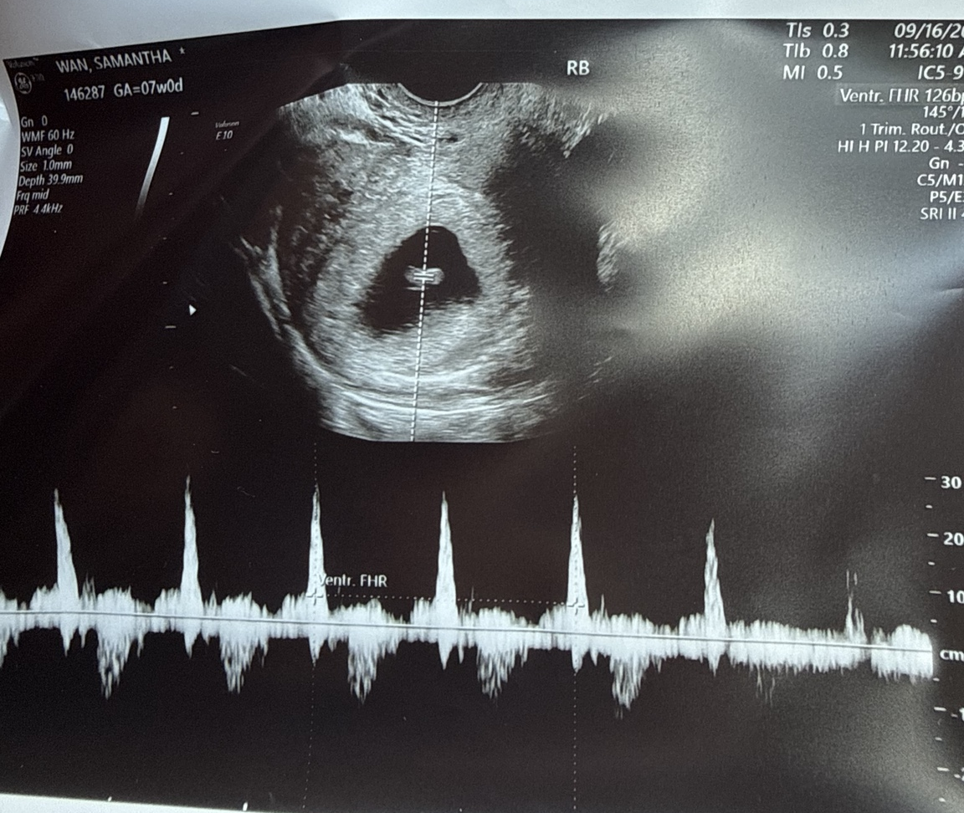
New project arriving April/May 2027

